Slide 1
Day 4 - Gii Yii

Slide 2
Getting Started
Gii is a module provided by Yii
To enable it, go to config/web.php and ensure this code is available
$config['bootstrap'][] = 'gii';
$config['modules']['gii'] = [
'class' => 'yii\gii\Module',
];
Next, go to web/index.php and ensure YII_ENV has set to dev
defined('YII_ENV') or define('YII_ENV', 'dev');
Next, open UrlManager.php and disable prettyUrl by setting to false. In your browser, open the link http://yourhost/index.php?r=gii

Slide 3
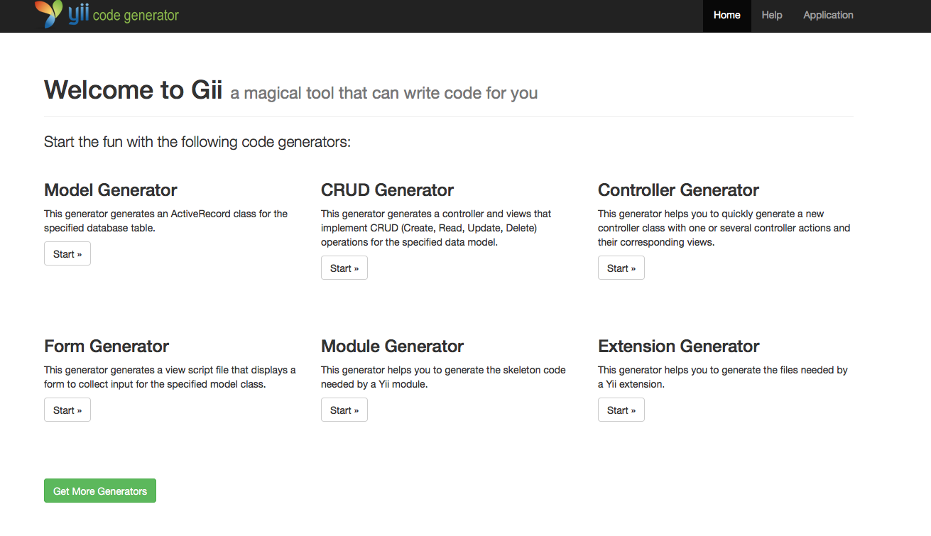
Getting Started
Gii has 6 Generators. We will cover Model, CRUD, Controller and Form Generator

Slide 4
Model Generator

Slide 5
Generate Model with Gii
Click Start

Slide 6
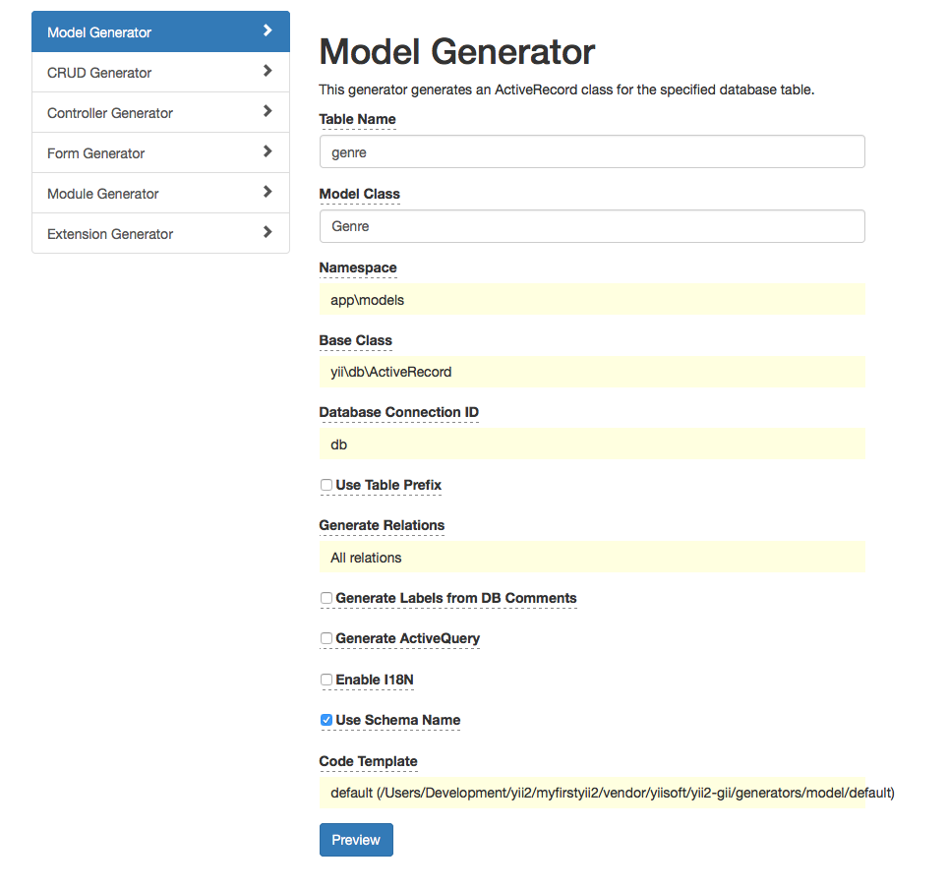
Generate Model with Gii
Fill in Table Name, Model Class Click Preview
Please make sure the table exist before generate the module

Slide 7
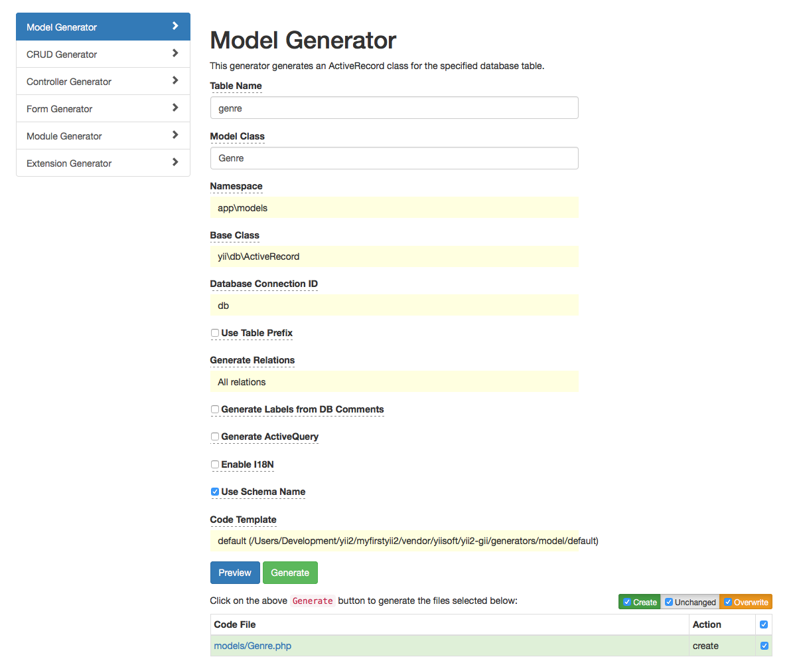
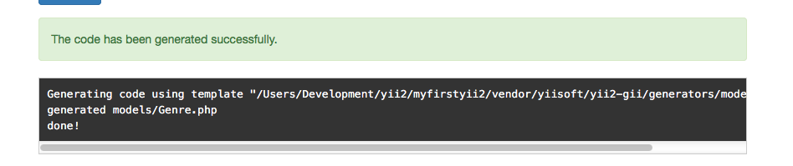
Generate Model with Gii
Tick Create, Unchanged and Overwrite. Then click Generate
Check the model file in /model

Slide 8
CRUD Generator

Slide 9
Generate CRUD with Gii
Click Start

Slide 10
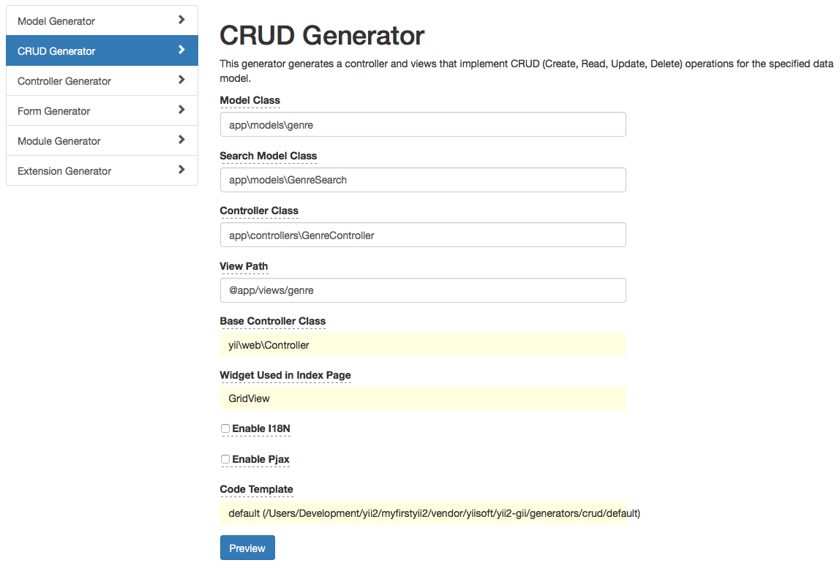
Generate CRUD with Gii
This will generate Controller, Search model and View files
Fill in Model Class, Search Model Class, Controller Class and View Path. Click Preview
Please make sure the model class exist before generate the module

Slide 11
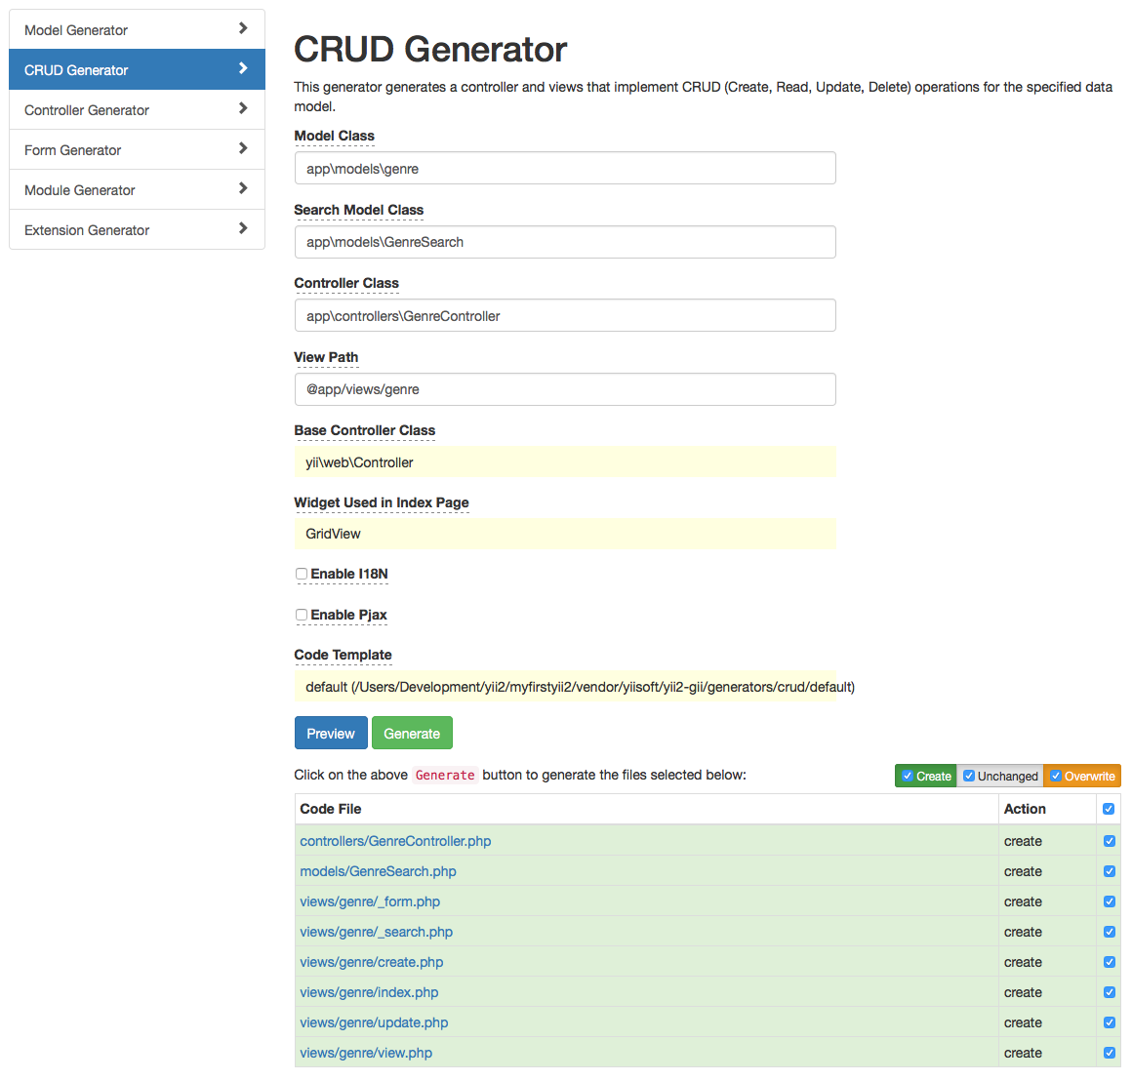
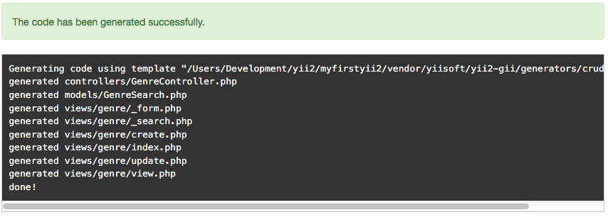
Generate CRUD with Gii
Tick Create, Unchanged and Overwrite. And tick all(next after Action). Then click Generate
Check the files in /model, /controller and /views

Slide 12
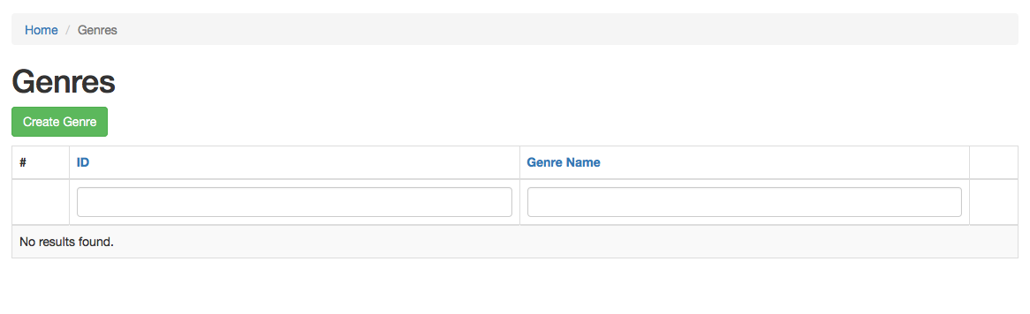
Generate CRUD with Gii
Basic CRUD has been created

Slide 13
Controller Generator

Slide 14
Generate Controller with Gii
Click Start

Slide 15
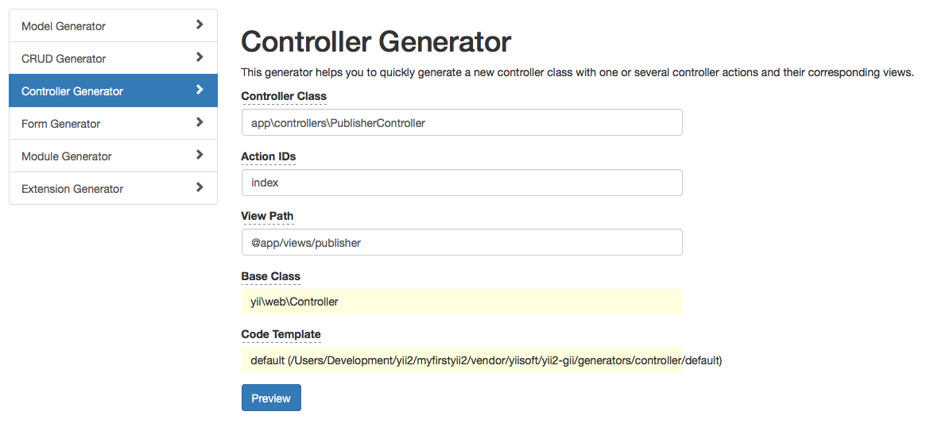
Generate Controller with Gii
Fill in Controller CLass, Action IDs, View Path. Click Preview

Slide 16
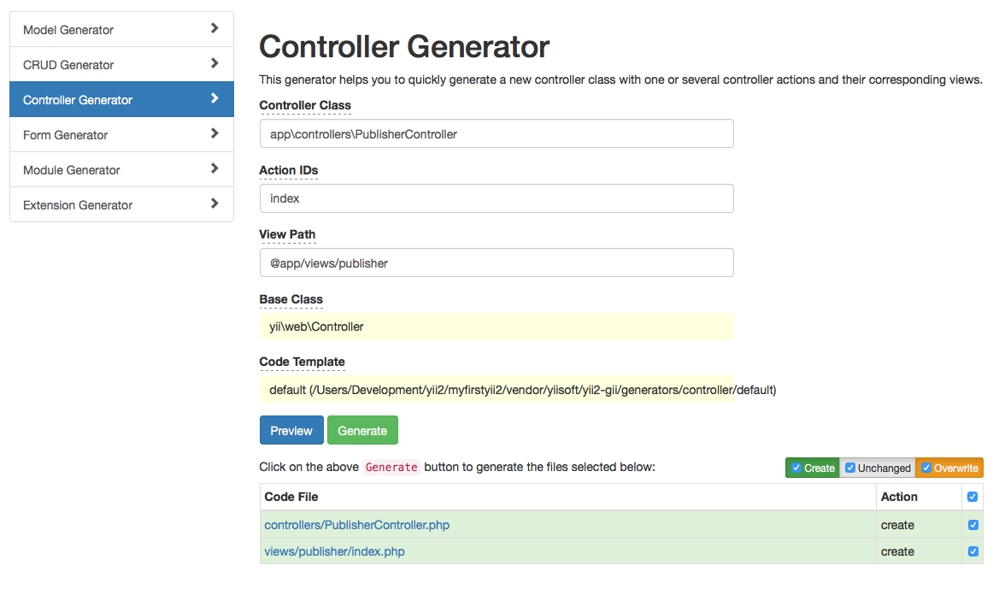
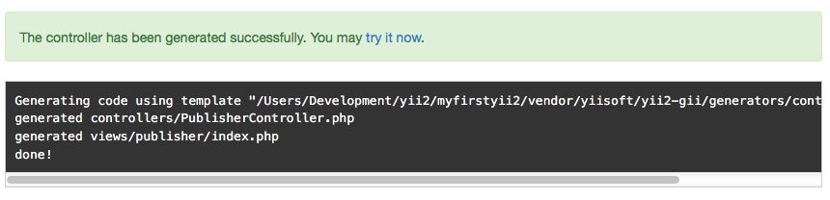
Generate Controller with Gii
Tick Create, Unchanged and Overwrite. And tick all(next after Action). Then click Generate
Check the files in /controller and /views

Slide 17
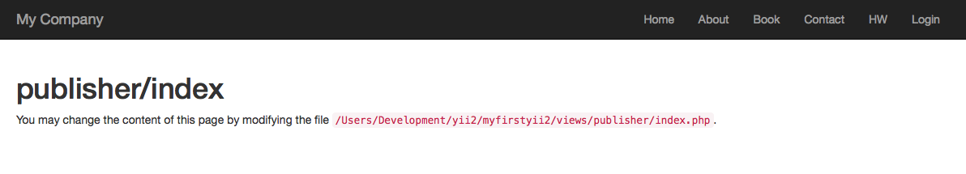
Generate CRUD with Gii
A default page has been created

Slide 18
Form Generator

Slide 19
Generate Form with Gii
Click Start

Slide 20
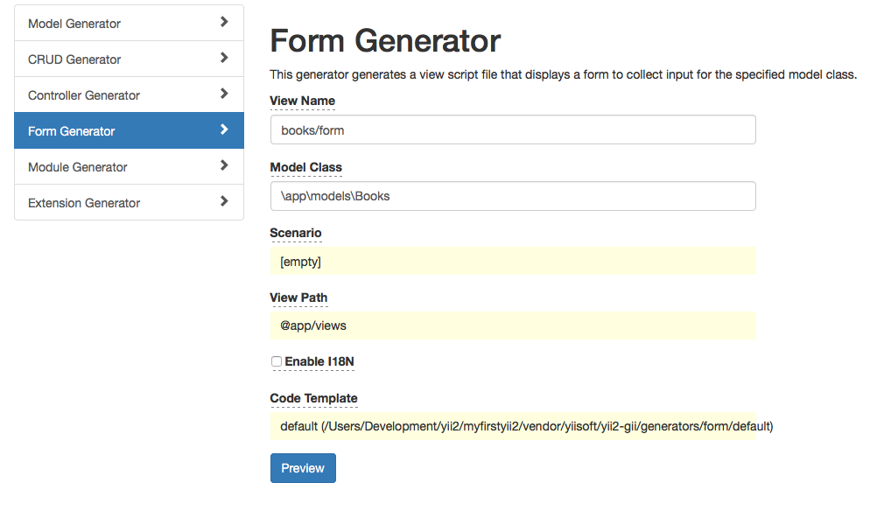
Generate Form with Gii
Fill in View Name, Model Class. Click Preview

Slide 21
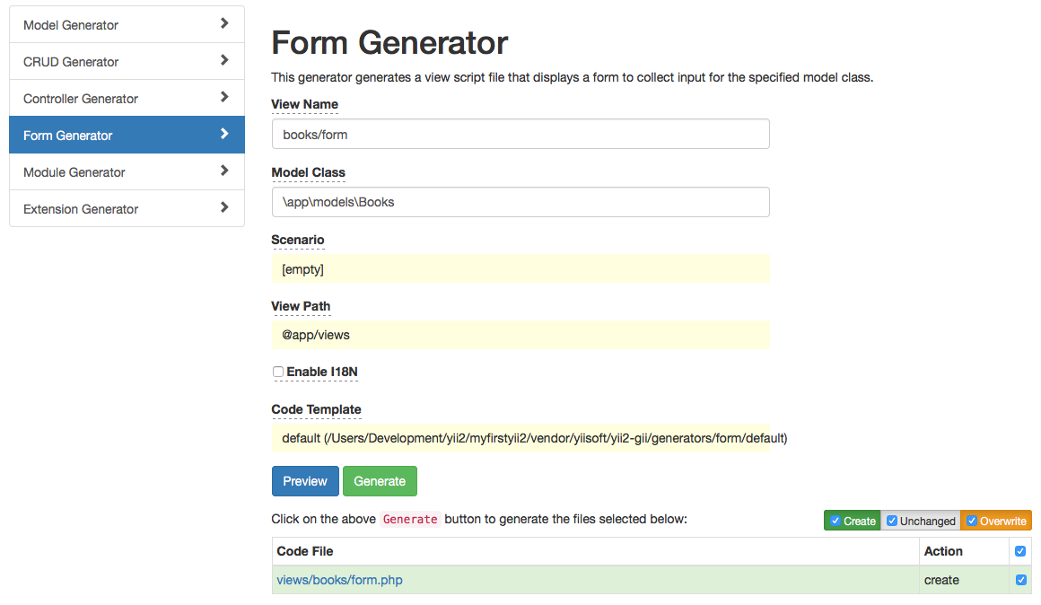
Generate Form with Gii
Tick Create, Unchanged and Overwrite. And tick all(next after Action). Then click Generate
Check the files in /views

Slide 22
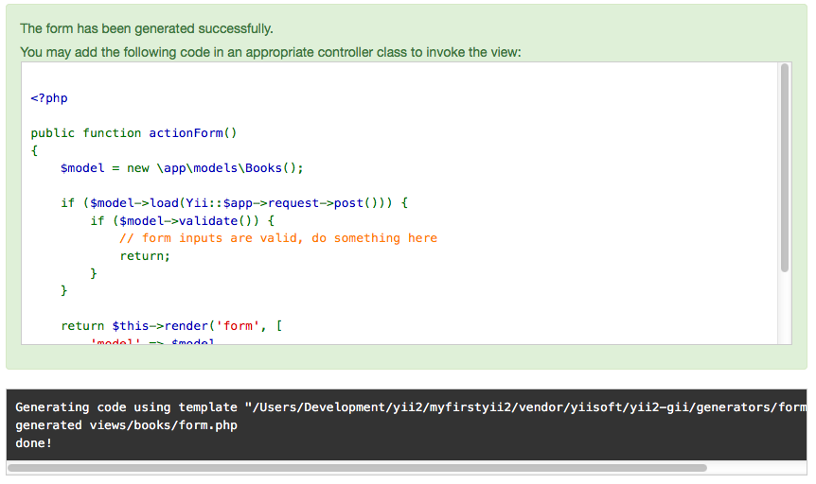
Generate Form with Gii
This message will tell you to copy and paste it inside the controller

Slide 23
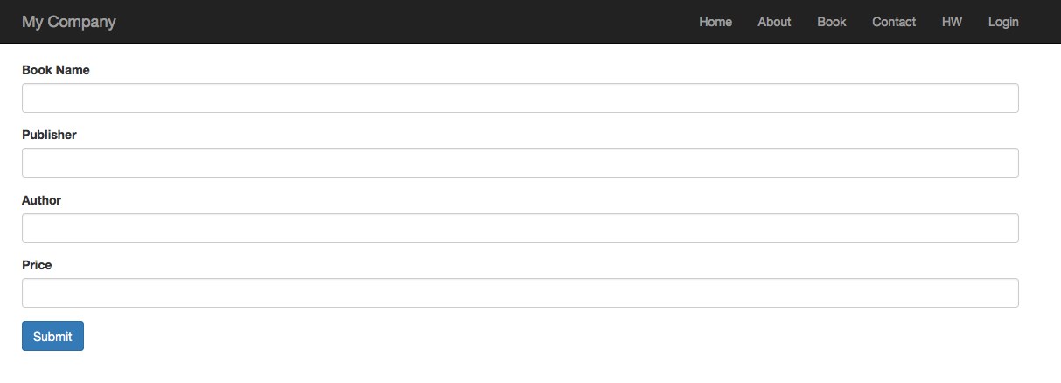
Generate Form with Gii
A basic form has been created

Slide 24
Exercise
Create a new table called company with field id, company_name, reg_num, business_type, business_owner
Generate model called company
Generate CRUD for company
Enable prettyURL in UrlManager.php and set the rules for the company CRUD
Add menu Genre inside /views/layout.main.php

